Slide 1
COVID-19 OFFICE OF HUMAN RESOURCES & SUPERINTENDENT OF SCHOOLS
Presenter: Glasshebra Jones, MPA, SHRM-CP
Executive Director of Human Resources/COVID-19 Manager
February 1, 2022

Slide 2
COVID MANAGEMENT
Glasshebra Jones, Executive Director of Human Resources/COVID-19 Manager
Gerald Fitzhugh, II, Ed.D, Superintendent of Schools
We collaboratively work with the Orange Health Department and School Nurse Practitioners within our district to ensure the safety of your children and staff.

Slide 3
AGENDA
Introduction
Center for Disease Control & Prevention, New Jersey Department of Education and NJ Health Dept. Update
Our Stay-at-Home Order
Mandatory Wearing of Mask
COVID-19 Quarantine Protocol
Reporting positive cases
Contact Tracing
Notification to Families
Remote Learning

Slide 4
WHAT OUR ROLE?
Our role is to work with school leadership to ensure that our students and staff are safe. Additionally, I conduct COVID-19 contact tracing across the district in partnership with the Office of the Superintendent and partnering health professionals.
We conduct investigations based on confirmed cases
Following the guidelines of the CDC and Local and State Health Departments we determine who meets the criteria of close contact, exposure and mandatory quarantine and notify accordingly.

Slide 5
DISTRICT UPDATES (January 2022)
NJDOE has advised districts that we may now follow the recent guidance provided by the CDC reducing the quarantine period for asymptomatic staff/students from 14 days to 5 calendar days.
All cases are reported using a data portal
Attachments: 1. Verification of Positive Diagnosis 2. Contact Tracing Information

Slide 6
OUR STAY-AT-HOME ORDER
Students and staff should stay home if they:
• Have tested positive for COVID-19.
• Are sick.
• Are not fully vaccinated and have had close contact with a person with COVID-19 in the past 14 days.

Slide 7
Mandatory
Wearing of Facial Mask
The New Jersey Mask Mandate issued by our Governor in August of 2021 is still in place. Students must continue to wear facial masks when in school. Exceptions include:
1. When doing so would inhibit the individual’s health, such as when the individual is exposed to extreme heat indoors; or
2. When the individual has trouble breathing, is unconscious, incapacitated, or otherwise unable to remove a face masks without assistance; or
3. When a student’s documented medical condition or disability, as reflected in an Individualized Education Program (IEP) or Educational Plan pursuant to Section 504 of the Rehabilitation Act of 1973, precludes use of a face mask; or
4. When the individual is under two (2) years of age; or

Slide 8
Mandatory wearing of Mask
7. When wearing a face mask creates an unsafe condition in which to operate equipment or execute a task.
5. When the individual is engaged in activity that cannot physically be performed while wearing a mask, such as eating or drinking, or playing a musical instrument that would be obstructed by a face mask; or
6. When the individual is engaged in high-intensity aerobic or anaerobic activity; g. When a student is participating in high-intensity physical activities during a physical education class in a well-ventilated location and able to maintain a physical distance of six feet from all other individuals; or

Slide 9
HERE'S HOW THE DISTRICT IS MANAGING COVID-19

Slide 10
What is the incubation period?

Slide 11
NOTIFICATION & REPORTING PROTOCOL (Parents)
Parents – Please report your child's diagnosis to your building principal and school nurse;
A copy of the positive diagnosis must be submitted as well
Your child's principal will ask you questions such as:
1. What day was your child last in school?
2. Do you have any other children in district? Siblings
3. Is your child symptomatic or asymptomatic?
4. Is your child fully vaccinated?
Contact Tracing will begin…

Slide 12
NOTIFICATION & REPORTING PROTOCOL (Staff)
Staff – Please report your diagnosis to your immediate supervisor and school nurse;
A copy of the positive diagnosis must be submitted as well
Your immediate supervisor will ask you questions such as:
1. What day were you last in school?
2. At anytime did you interact with any staff/students without a mask and/or without practicing social distancing?
3. Are you symptomatic?
4. Are you fully vaccinated?
Contact Tracing will begin…

Slide 13
Conducting Contact Tracing CRITERIA FOR CLOSE CONTACT
A close contact is defined as someone who was less than 6 feet away from a person with infection (lab confirmed or clinical diagnosis) for a cumulative time of 15 minutes or more, over a 24-hour period.
In the K–12 indoor classroom setting or a structured outdoor setting where mask use can be observed (i.e., holding class outdoors with educator supervision), the close contact definition excludes students who were between 3 to 6 feet of an infected student (laboratory-confirmed or a clinical diagnosis) if both the infected student and the exposed student(s) correctly and consistently wore well-fitting masks the entire time.
Precautionary Principle – Severe Risk – Ex. 1 class period of 45 minutes, possibly mandatory quarantine

Slide 14
COVID-19 EXPOSURE: Exposed close contacts who have no COVID-19 symptoms and are not fully vaccinated:
1. Should be tested immediately upon notice of exposure and if positive will be subject to contact tracing;
2. Retest 5- 7 days post self-isolation; Testing should be performed only if fever-free for 24 hours and other symptoms have improved (or if symptoms were not present). If the test result is negative, isolation can end, but continue to wear a well-fitting mask around others at home and in public until day 10.
If the test result is positive, continue to self-isolate until day 10. Student/staff would return on day 11.
*If the student/staff completes a full 10-day isolation; testing is not required to return on-site.
Notes:
Instructor notes:
The CDC uses the term Person Under Investigation (PUI) for a suspect case.
A suspect case or PUI is a person who has both consistent symptoms and risk factors as follows:
Clinical criteria, which includes cough, fever, and shortness of breath; AND
risk factors within the past 14 days before the onset of symptoms, such as contact patient known to have or suspected to have COVID-19; residence in—or travel to—an area where COVID-19 transmission is active; or direct handling of bats or non-human primates from disease areas.
https://www.cdc.gov/coronavirus/2019-ncov/php/guidance-evaluating-pui.html
https://www.cdc.gov/coronavirus/2019-ncov/php/reporting-pui.html

Slide 15
COVID-19 EXPOSURE Exposed close contacts who have no COVID-19 symptoms and ARE fully vaccinated:
•Not required to quarantine or be excluded from school (Can return; no break)
• Should test 5-7 days following exposure to someone with COVID-19
• Should monitor for symptoms of COVID-19 for up to 10 days following an exposure
• Must wear a mask in other indoor public settings for up to10 days or until they receive a negative test result.

Slide 16
COVID-19 EXPOSURE: Unvaccinated Persons 90 day Diagnosis:
Do not need to quarantine or be excluded from school
Should not be tested for COVID-19 but should still monitor for symptoms for 10-14 days following exposure
What does this mean? Individuals who recently tested positive will not be placed in quarantine in the event they are exposed within the next 90 days.
Example: Positive Test: February 1, 2022 Non-Quarantine Period Expires: May 2, 2022

Slide 17
QUARANTINE GUIDANCE DUE TO SCHOOL EXPOSURE
Status | Quarantine/Self-Isolation​ | Testing Mandate​ | Return-to-Work​
Vaccinated Staff/Students​ | Not Required to Quarantine​ | Testing Not Required ​ ​ Staff must monitor for symptoms​ | No break in service/school​
Unvaccinated Staff/Students​ *PCR Test Required​ | Mandatory Quarantine If within 6 feet/no mask​ | 1. Must test at time of notification​ (Contact tracing) 2. A second test (PCR) is required 5-7 days post exposure. ​ | Must have PCR ​ to return-to-work/school​ (Round II testing) ​
Unvaccinated Staff/Students ​ 90 Day Positive​ ​ (Any person that tested positive for COVID-19 within 90 days of exposure)​ | Not required to Quarantine​ ​ Must monitor for Symptoms;​ | Testing is highly recommended​ | No break in service/school​

Slide 18
Household/Family Exposure
In all risk levels, students and staff who are not fully vaccinated and are household members of a student/staff member with COVID-19 compatible symptoms should be excluded from school until the symptomatic individual receives a negative test result.
However, if there is an effective isolation plan in place, the negative family member may be permitted to report in district.

Slide 19
ILLNESS WHILE ON THE SCHOOL SITE
Children and staff with COVID-19 symptoms should be separated away from others until they can be sent home. Students who are sick and not already wearing a mask should be provided one to wear unless the student has a contraindication to doing so. If a mask is not tolerated by the ill student or staff member, other staff should be masked and follow maximum physical distancing guidelines (at least 3 feet away).
Ask ill student (or parent/guardian) and staff whether they have had potential exposure to COVID-19 in the past 14 days meeting the definition of a close contact. Individuals should be sent home and referred to a healthcare provider. Persons with COVID-19- compatible symptoms should undergo COVID-19 testing.
Schools with testing capacity should test ill students and staff, consistent with any federal and state requirements, including requirements regarding parental consent. Ill individuals who test positive should be reported to the LHD and contact tracing should begin. Ill individuals that test negative should be referred to a healthcare provider, who may consider additional COVID-19 testing.

Slide 20
UNVACCINATED STAFF – Weekly Testing
Unvaccinated staff are required to upload their weekly testing results or test onsite -no exceptions.
Principals must support the district in ensuring that these individuals test weekly.
School Nurses are also responsible for ensuring the health and safety of all staff & students; relative tasks will be assigned accordingly as per the job description.
Staff who fail to submit their weekly test results shall be denied entry into the building, resulting in a charge of their accrued personal time (sick/pers/vacation days). Continued failure will result in disciplinary action. You will be notified in writing of any person who has not submitted their weekly testing results.

Slide 21
Weekly Testing Onsite REGISTRATION REQUIRED

Slide 22
POST TRAVEL – Students/Staff
Fully vaccinated travelers are not required to quarantine or be tested before or after domestic travel unless the travel destination requires such.
If traveling internationally, fully vaccinated individuals do not have to be tested to leave the U.S. unless the destination country requires it. However, unvaccinated individuals are required to PCR test before returning to district.

Slide 23
WHAT ACTIVITIES CAN A STUDENT OR STAFF MEMBER PARTICIPATE IN WHILE IN QUARANTINE?
A student or staff member should participate in only online or virtual school activities during their quarantine period. They may complete work or assignments from home during this time, depending on how well they feel. They can engage with other students, teachers, or staff through phone conversations, online meetings, or fully virtual engagement.
It is important for a student or staff member in quarantine to remain at home, separated from other people as much as possible, during the entire quarantine period. They should not attend other extra-curricular or social activities while they are in quarantine. They should not participate in activities like sporting events, play dates, parties, social and family gatherings, music or theater performances, and other events where they may come into contact with other people. To prevent other people from possibly getting COVID-19, make every effort to limit the person’s contact with other people, including members of their household, while they are in quarantine, even if the person is wearing a mask.

Slide 24
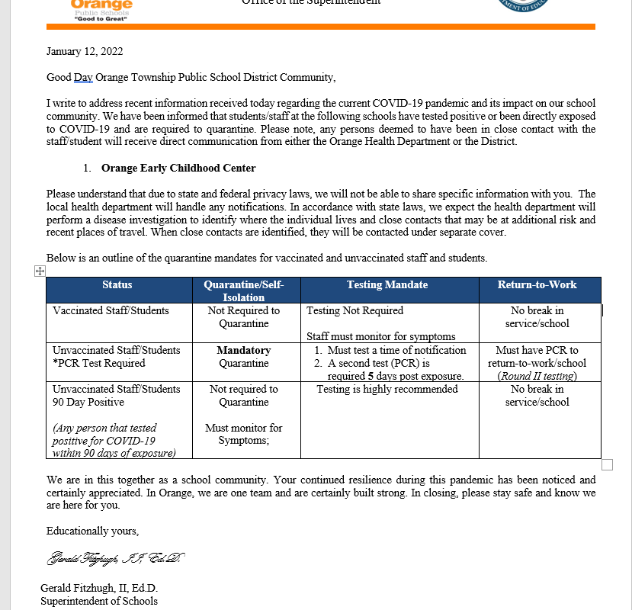
NOTICE to All Staff & Positive Employee

Slide 25
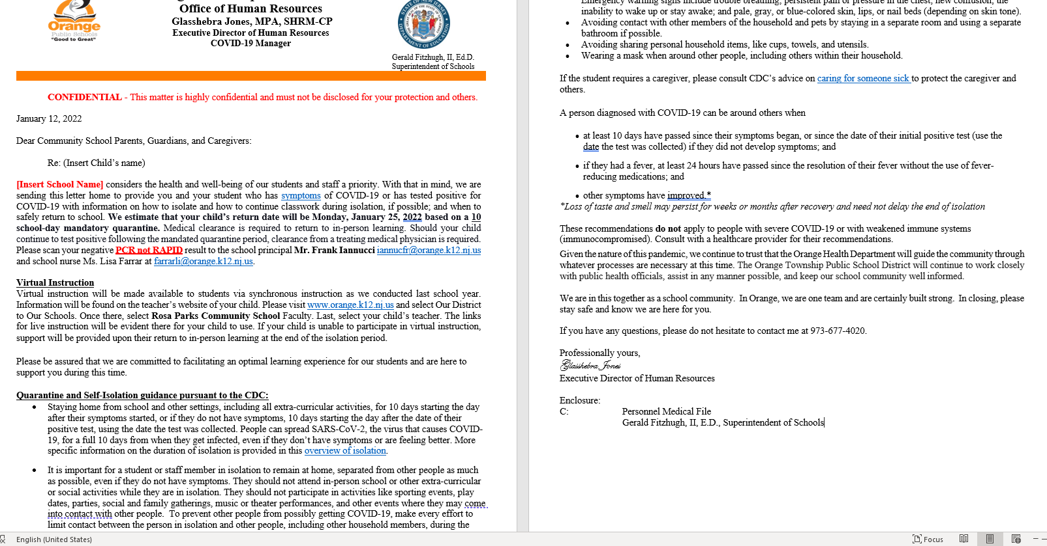
Notice to Parents/Community

Slide 26
Staff - Reporting Absences
Staff members that test positive outside of the district will be required to use their personal accrued time. (Sick, Personal or Vacation Days)
All absences must be reported to Frontline – Absence Management.
Contact Tracing
Staff members placed in quarantine as a result of contact tracing will not be charged their accrued time.

Slide 27
Remote/Hybrid Learning
Hybrid - Remote Learning is available to all students in placed in quarantine and acknowledged by the district.
Remote learning will not be extended for any other reason other than mandatory quarantine/illness due to COVID-19. Parents must provide a medical certification to the building principal/school nurse.

Slide 28
Questions?
If you have any questions related to COVID-19, please contact Ms. Shebra Jones at
973-650-7235 or 973-677-4020. Email: jonesshe@orange.k12.nj.us

